Slide 1


Python QML Arduino GUI Practical Training Handout
Written by :
Muhammad Husni Muttaqin, S. Pd
Diky Zakaria, M. T.
PROGRAM STUDI MEKATRONIKA DAN KECERDASAN BUATAN
UPI KAMPUS DAERAH PURWAKARTA
AGUSTUS 2022

Slide 2
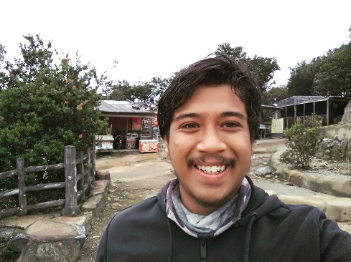
About me
Name : Muhammad Husni Muttaqin, S. Pd.
Birth date : 5 June 1998
Hometown : Bandung
Current Job : python programmer at PT Syergie Indoprima and part time teacher
Experiences :
- 2019 - 2020 : Dynamics Positioning System engineer on cable ship (PT Syergie Indoprima)
- 2021 - 2022 : Electronics and control system engineer for Vent-I (PT Syergie Automa Teknologi)
- 2022 – now : Python Programmer PT Syergie Indoprima

Slide 3
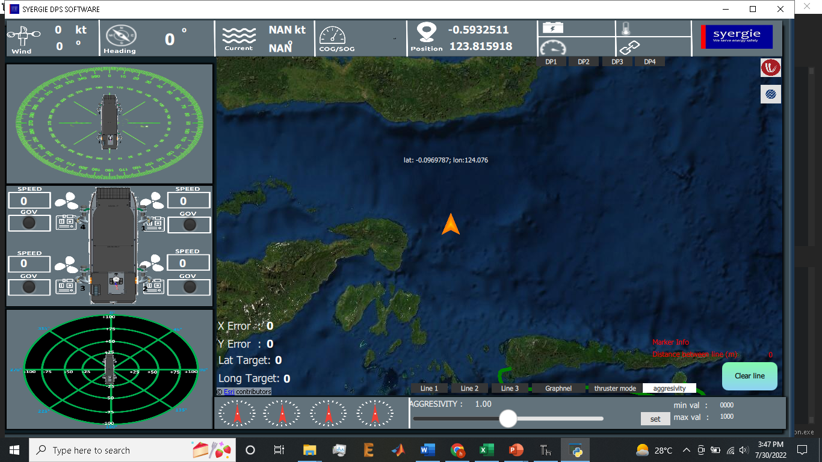
My experiences using python QML
1. Software Dynamic Positioning System

Slide 4
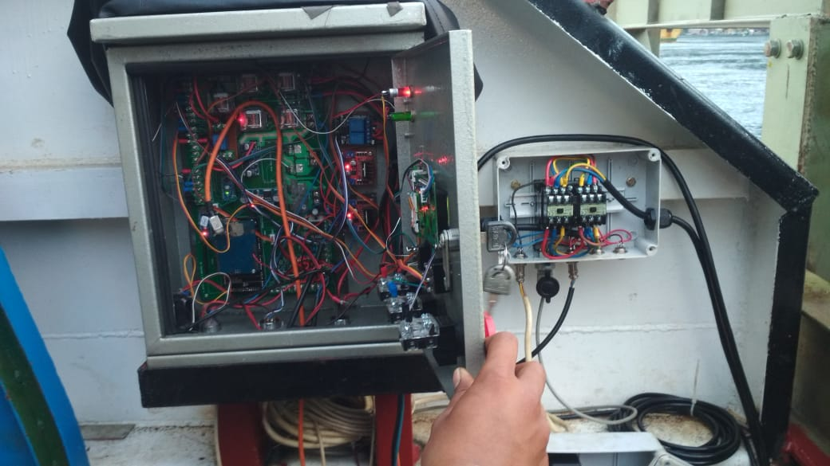

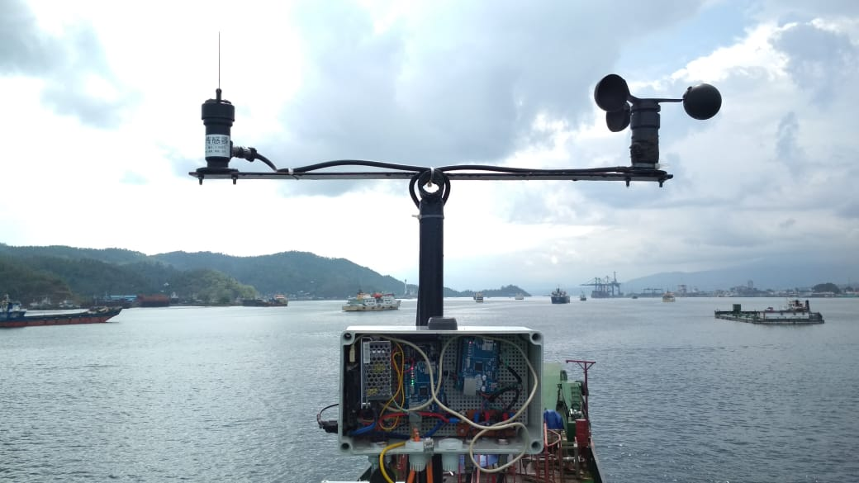
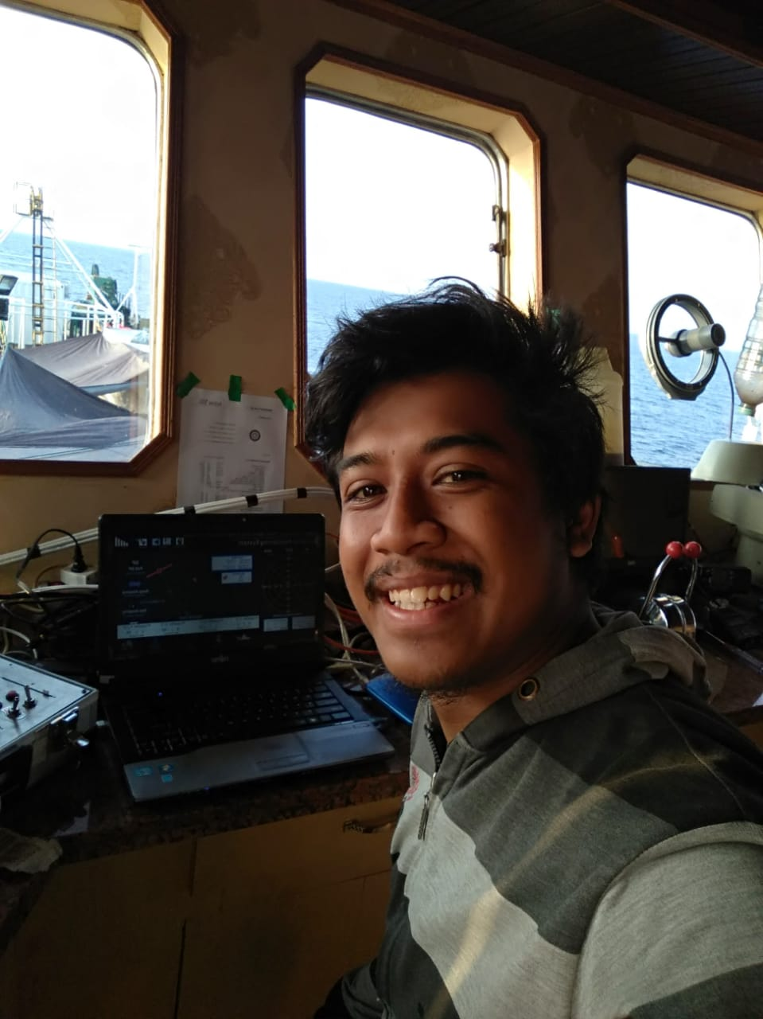
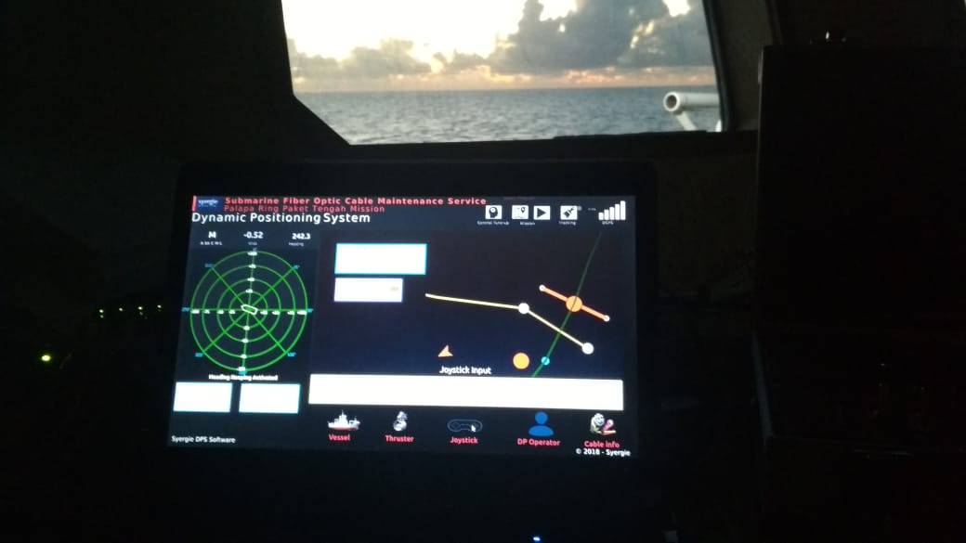

Slide 5
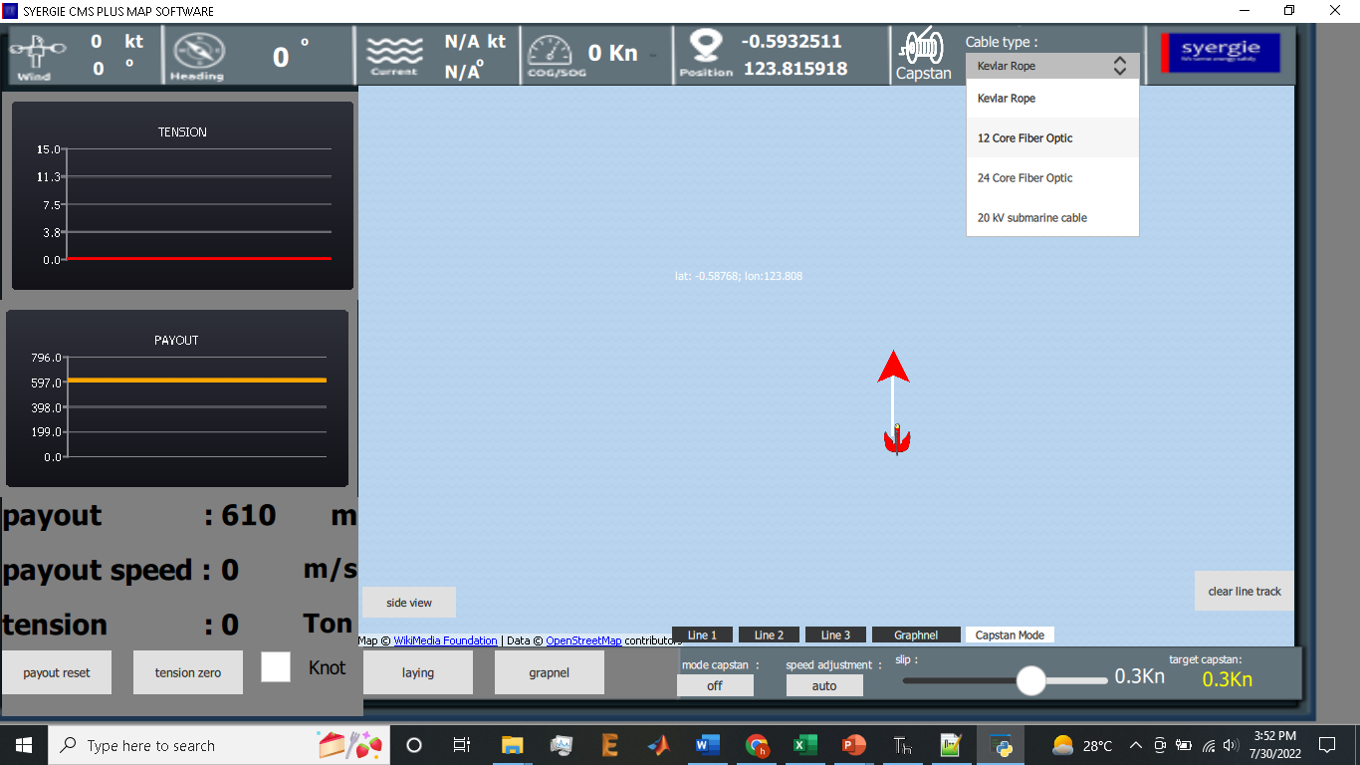
My experiences using python QML
2. Software Cable Management System

Slide 6
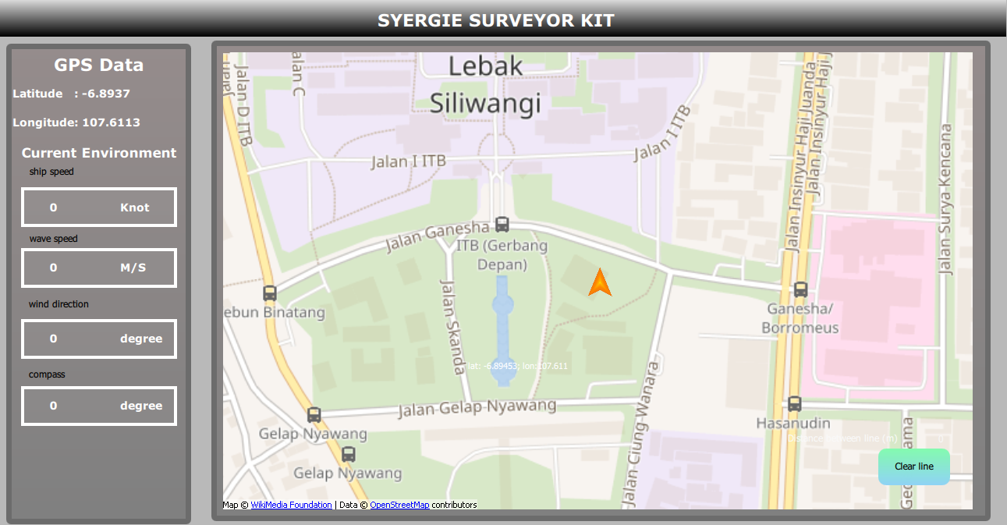
My experiences using python QML
3. Software Survey Arus bawah laut

Slide 7
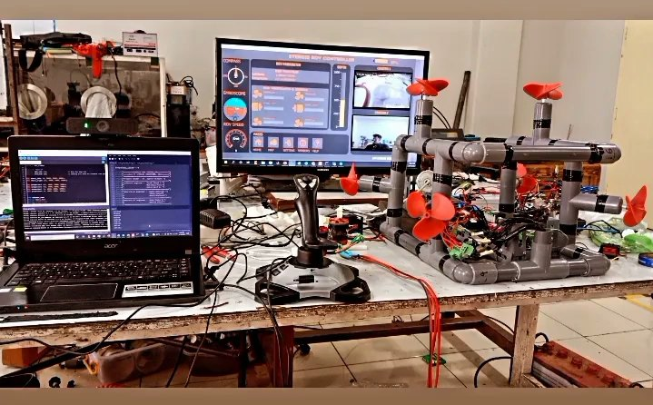
My experiences using python QML
4. Software kendali Underwater ROV

Slide 8
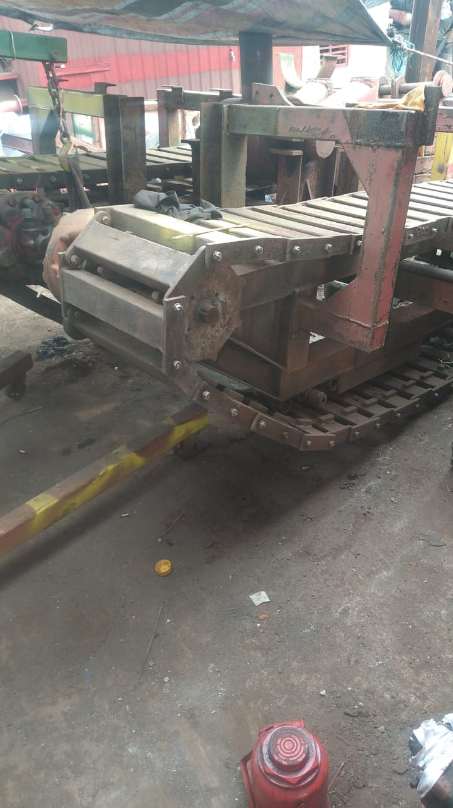

Slide 9
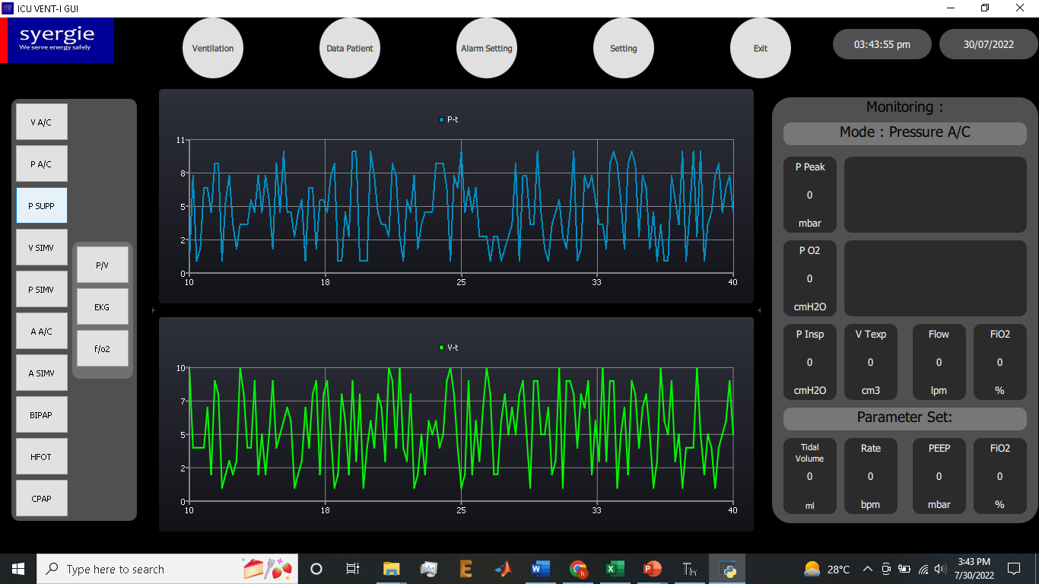
My experiences using python QML
5. ICU Ventilator GUI

Slide 10
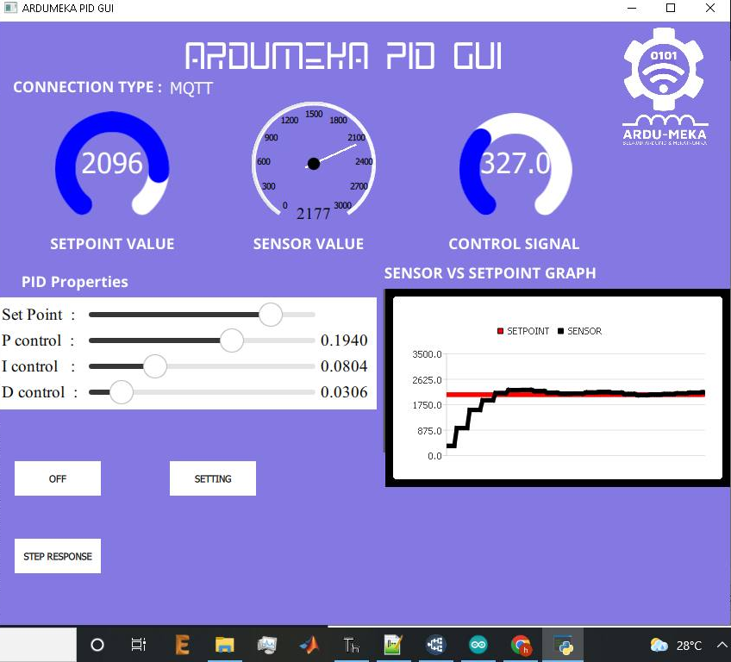
My experiences using python QML
6. Ardumeka PID GUI

Slide 11
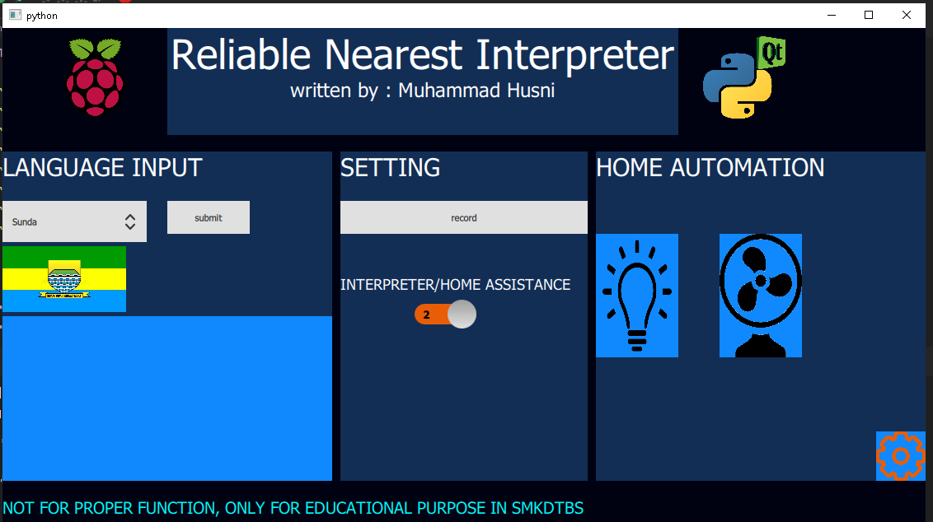
My experiences using python QML
7. On progress : ReNI (Reliable Nearest Interpreter)

Slide 12
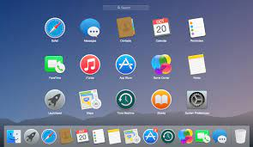
What is GUI ?

Slide 13
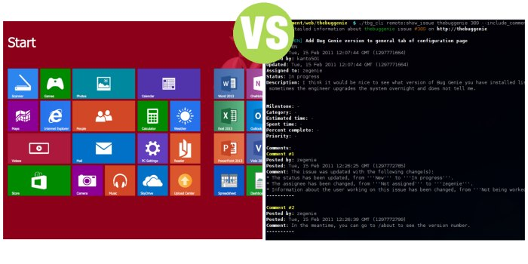
GUI vs CLI

Slide 14
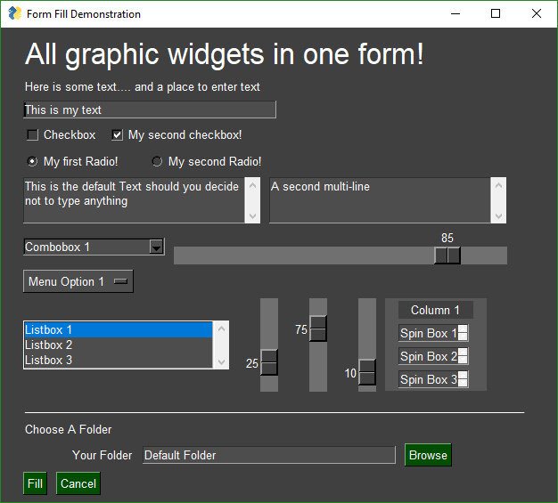
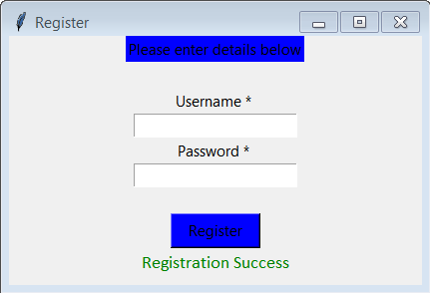
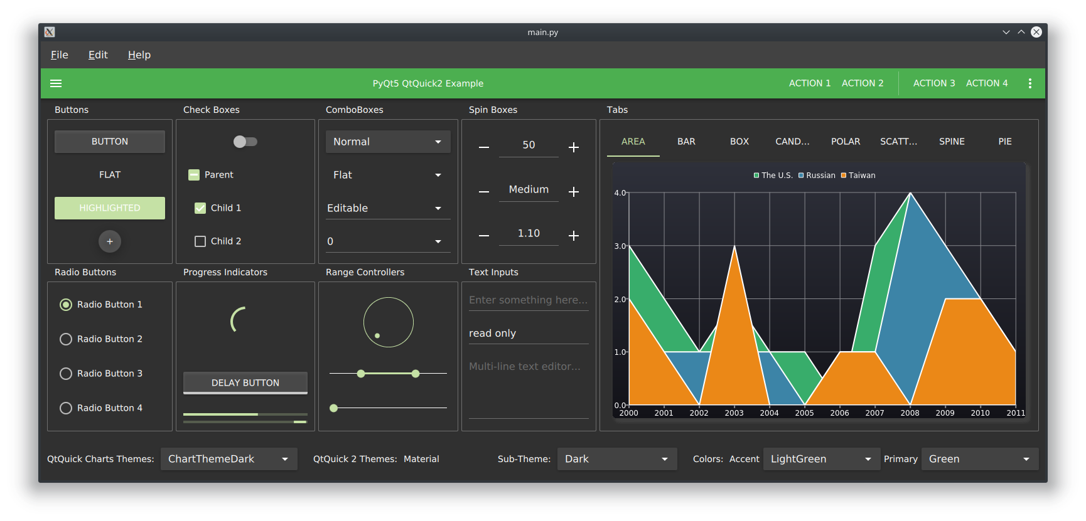
Python GUI
Tkinter
PySimpleGUI
PyQt QML

Slide 15
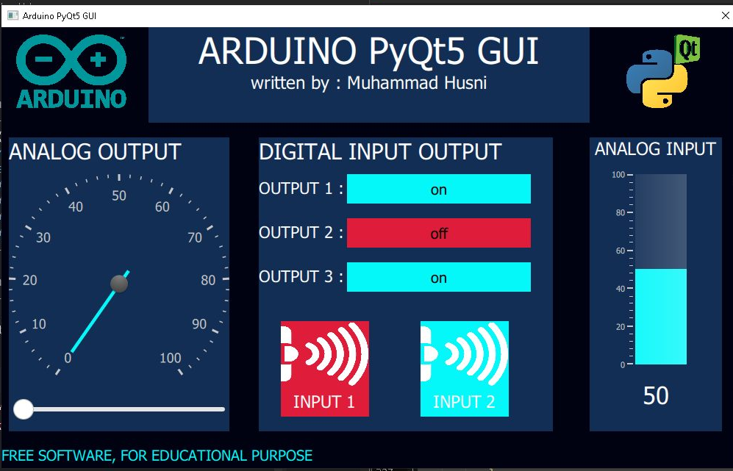
Today Workshop Project with PyQt5

Slide 16
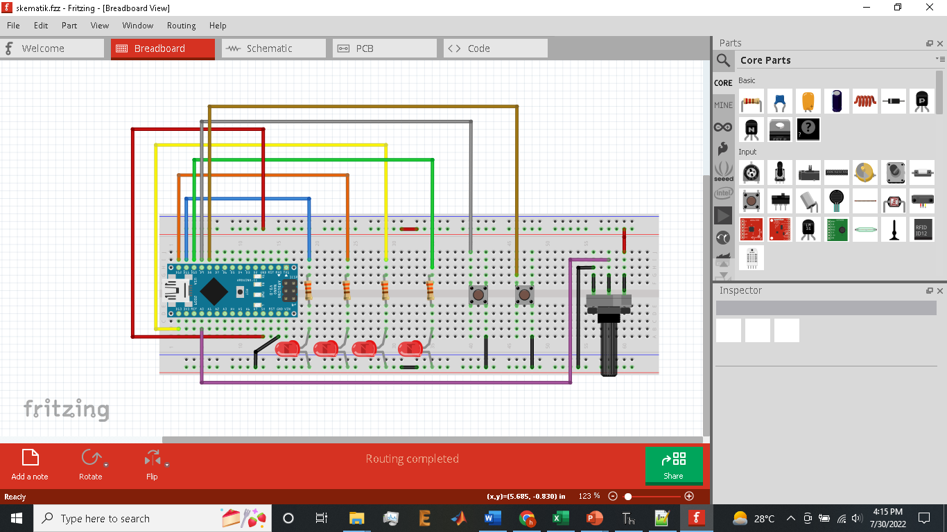
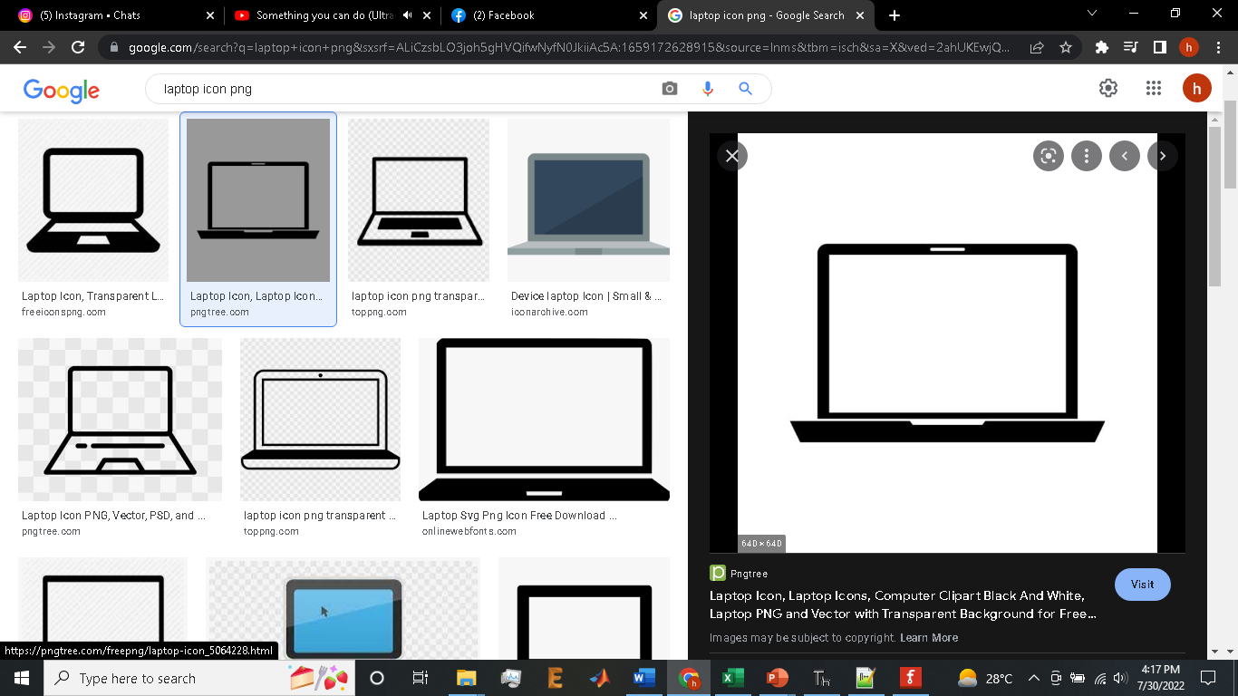

Slide 17
timeline
75 minutes practice
30 minutes QnA and debug
15 minutes preparation
Total : 120 Minutes

Slide 18
Preparation
Software Installation
Notepad++
Thonny IDE
- PyQt5 Library
Arduino IDE
CH340 Driver

Slide 19
Hardware Wiring

Slide 20
RUN EXAMPLE CODE FIRST TO MAKE SURE PREPARATION DONE PERFECTLY ☺

Slide 21
HOW PyQt5 WORK
1
1 add windows
2 add text
3 Add button
4 Add slider
5 Add image
6 Add gauge and circular gauge
7 Integrate python and qml
8 Serial data parsing
5
2
3
6
6
4

Slide 22
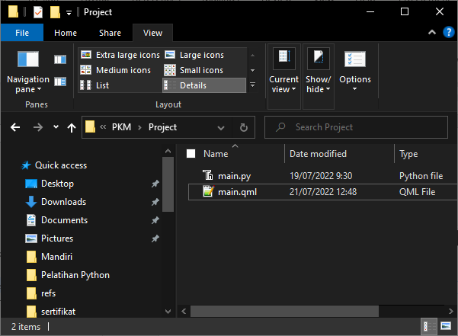
Create new folder
.py
.qml

Slide 23
Python base code
from PyQt5.QtCore import *
from PyQt5.QtGui import *
from PyQt5.QtQml import *
from PyQt5.QtWidgets import *
from PyQt5.QtQuick import *
import sys
class table(QObject):
def __init__(self, parent = None):
super().__init__(parent)
self.app = QApplication(sys.argv)
self.engine = QQmlApplicationEngine(self)
self.engine.rootContext().setContextProperty("backend", self)
self.engine.load(QUrl("main.qml"))
if __name__ == "__main__":
main = table()

Slide 24
Qml base code
import QtQuick 2.12
import QtQuick.Window 2.13
import QtQuick.Controls 2.0
import QtQuick.Controls.Styles 1.4
import QtQuick.Extras 1.4
import QtQuick.Extras.Private 1.0
Window {
id : root
width: 400
height: 400
title:"membuat windows"
color : "pink"
visible: true
//flags: Qt.WindowMaximized //Qt.Dialog
}

Slide 25
Experiment
Make your windows with your favorite color ☺

Slide 26
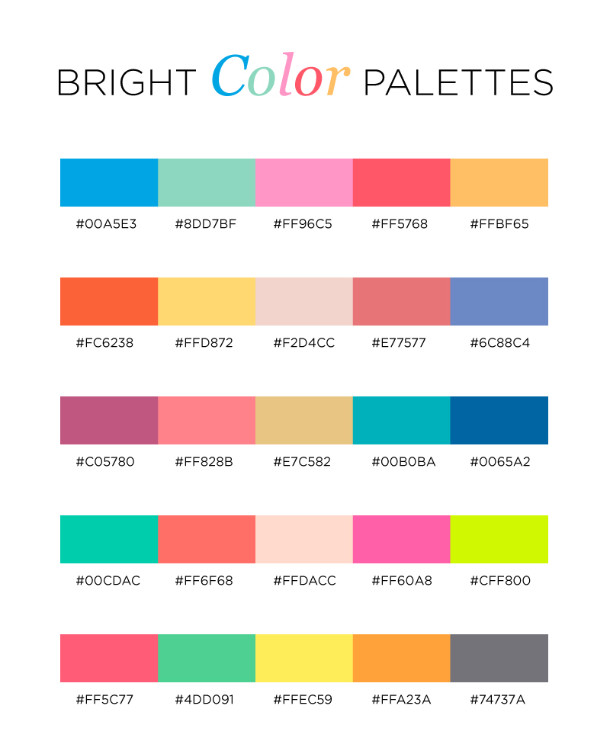
Little tricks => color pallete
color : “#FF96C5"

Slide 27
Add some text on your window
Text{
id : text1
x:100
y:200
text:"Hello World"
color: "#00FF00"
font.family : "Comic Sans MS"
font.pixelSize: 35
font.bold : true
}
WRITE YOUR NAME ON YOUR WINDOW

Slide 28
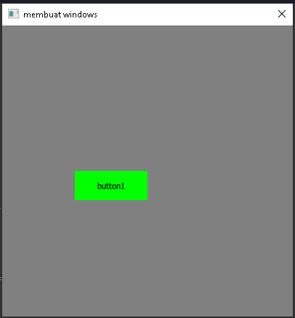
Add some buttons on your window
Button {
id: button1
x :100
y :200
text: "button1"
palette {
button: "#00FF00"
buttonText: "black"
}
onClicked:{
}
}
MAKE THREE BUTTONS

Slide 29
Little tricks => toggle button
Button {
id: button3
x :120
y :170
width : 250
text: "off"
font.pixelSize : 20
onClicked:{
if(button3.text == "on"){
text = "off";
button3_color.color = "#df1c39"
}else
if(button3.text == "off"){
text = "on";
button3_color.color = "#04f8fa"
}
}
}

Slide 30
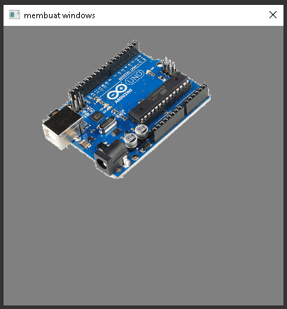
Add some picture on your window
Image{
x:50
y:0
width : 250
height : 250
source:"arduino.png"
}

Slide 31
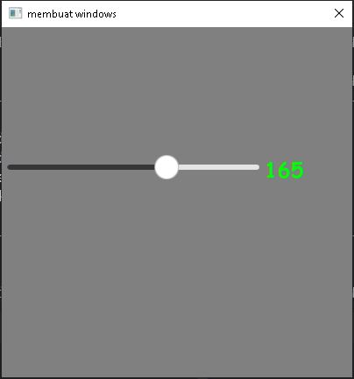
Add slider on your window
Slider {
id: slider1
x:0
y:150
height: 20
width: 300
value: 0
from:10
to: 255
stepSize: 5
orientation: Qt.Horizontal
onValueChanged: {
}
}

Slide 32
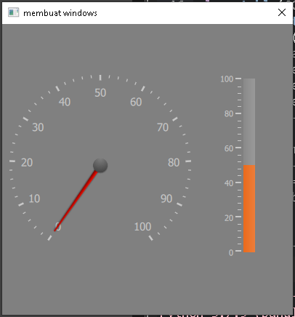
Add gauge on your window
Gauge {
id : gauge2
x: 300
y: 70
height : 250
width : 250
minimumValue: 0
value: 50
maximumValue: 100
tickmarkStepSize: 20
style: GaugeStyle {
valueBar: Rectangle {
color: "#e85d08"
implicitWidth: 16
}
}
}

Slide 33
Add circular gauge on your window
CircularGauge {
id : gauge1
x: 10
y: 70
height : 250
width : 250
value: 0
minimumValue: 0
maximumValue: 100
style: CircularGaugeStyle {
labelStepSize: 10
}
}

Slide 34
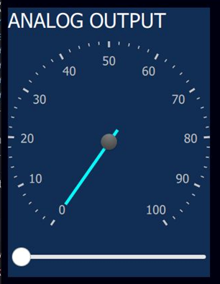
Little tricks => grouping using Rectangle
Rectangle{
x: 200
y:0
width : 600
height : 130
color : "#122e55“
//insert your QML Component inside here ☺
}

Slide 35
Integrate python with qml
Python <= QML
class table(QObject):
def __init__(self, parent = None):
super().__init__(parent)
self.app = QApplication(sys.argv)
self.engine = QQmlApplicationEngine(self)
self.engine.rootContext().setContextProperty("backend", self)
self.engine.load(QUrl("main.qml"))
##############TOMBOL QML KE PYTHON ##########
@pyqtSlot(str)
def button1(self, message):
print(message)
##########SLIDER QML KE PYTHON###################
@pyqtSlot(str)
def analog_output(self, message):
print(message)
Button {
…….
onClicked:{
backend.button1(“clicked")
}
}
Slider {
…….
onValueChanged:{
backend.button1(“clicked")
}
}

Slide 36
Integrate python with qml
Python => QML
Timer{
id:transferdata
interval: 50
repeat: true
running: true
onTriggered: {
pot_val.text = backend.get_analog()
}
}
##########KIRIM DATA ANALOG KE GAUGE##############
@pyqtSlot(result=float)
def get_analog(self): return analog

Slide 37
Python to Arduino Data Parsing
Preparations :
Make sure the wiring was correct
Make sure the COM was detected, if not you must install CH340 driver
- Upload “FIRMWARE.INO” to your Arduino
- Test by using the my example code

Slide 38
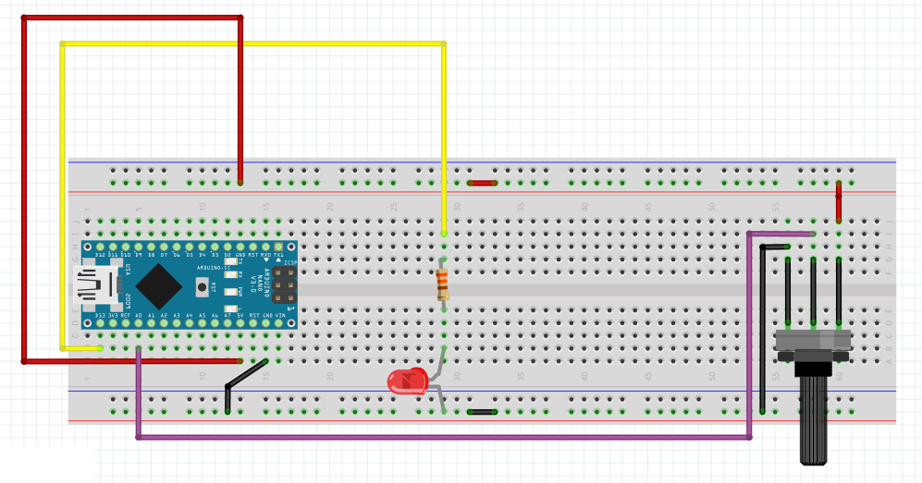
Basic serial communication
H : led on
L : led off
0-1023

Slide 39
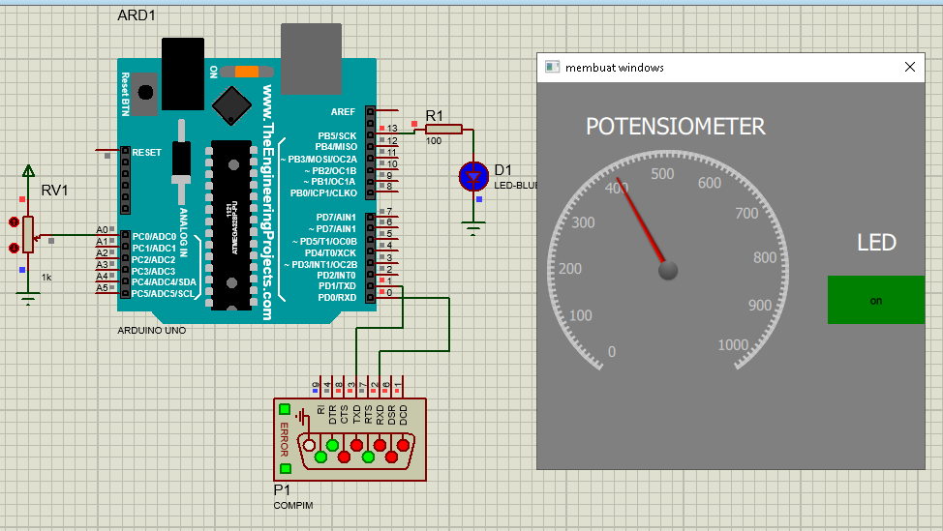
Basic serial communication

Slide 40
Python to Arduino Data Parsing
Python to Arduino
* (val 1) | (val 2) | (val 3) | (val 4)
Arduino to Python
(val 1) : (val 2) : (val 3)

Slide 41
def serial_read(num):
global ser_bytes
global decoded_bytes
global serial_data
global analog
global data
global input1_color
global input2_color
while True:
try:
ser_bytes = ser.readline()
serial_data = (ser_bytes.decode('utf-8')[:-2])
#print(serial_data)
except:
serial_data = serial_data
data = serial_data.split(":")
analog = int(data[0])
if (data[1] == "0"):
input1_color = "#df1c39"
else:
input1_color = "#04f8fa"
if (data[2] == "0"):
input2_color = "#df1c39"
else:
input2_color = "#04f8fa"
time_send = millis() - prev_time_send;
if (time_send > 500){
Serial.print(analogRead(pot));
Serial.print(":");
Serial.print(!digitalRead(button1));
Serial.print(":");
Serial.print(!digitalRead(button2));
Serial.println("");
prev_time_send = millis();
}

Slide 42
def serial_write(num):
global transmit_time
global transmit_time_prev
global data_send
while True:
transmit_time = time.time() - transmit_time_prev
data_send = (str("*") + str(button1_status) + str("|")
+ str(button2_status) + str("|")
+ str(button3_status) + str("|")
+ str(analog_output) +str("|")
)
if (transmit_time > 0.5):
print(data_send)
ser.write(data_send.encode())
transmit_time_prev = time.time()
while (Serial.available()>0){
delay(10);
c = Serial.read();
myString += c;
data_buffer = myString;
}
if (myString.length()>0){
Index1 = myString.indexOf('*');
Index2 = myString.indexOf('|', Index1+1);
Index3 = myString.indexOf('|', Index2+1);
Index4 = myString.indexOf('|', Index3+1);
Index5 = myString.indexOf('|', Index4+1);
secondValue = myString.substring(Index1+1, Index2);
thirdValue = myString.substring(Index2+1, Index3);
fourthValue = myString.substring(Index3+1, Index4);
firstValue = myString.substring(Index4+1, Index5);
myString="";
}
led1_status = fourthValue.toInt();
led2_status = thirdValue.toInt();
led3_status = secondValue.toInt();
led_pwm_val = firstValue.toInt();
digitalWrite(led1, led1_status);
digitalWrite(led2, led2_status);
digitalWrite(led3, led3_status);
analogWrite(led_pwm, led_pwm_val);

Slide 43
Let’s see the result ☺

Slide 44
Thanks for your participation, I hope this means more for all of you ☺

Slide 45
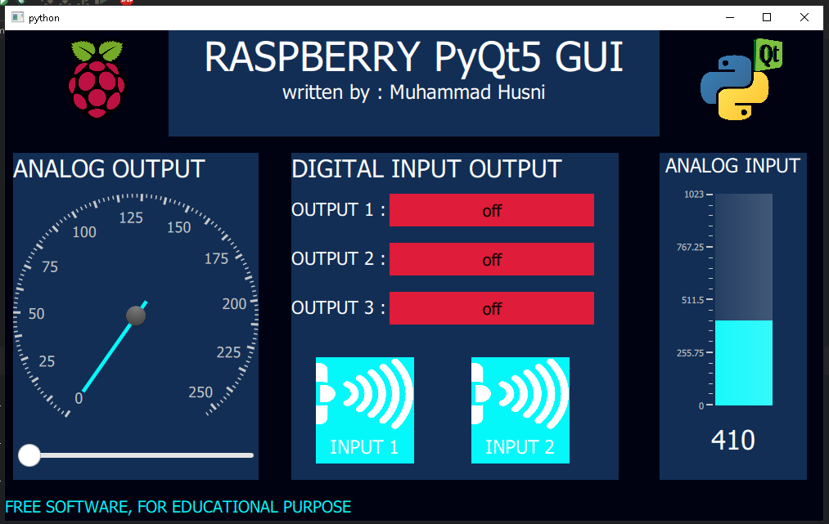

Slide 46
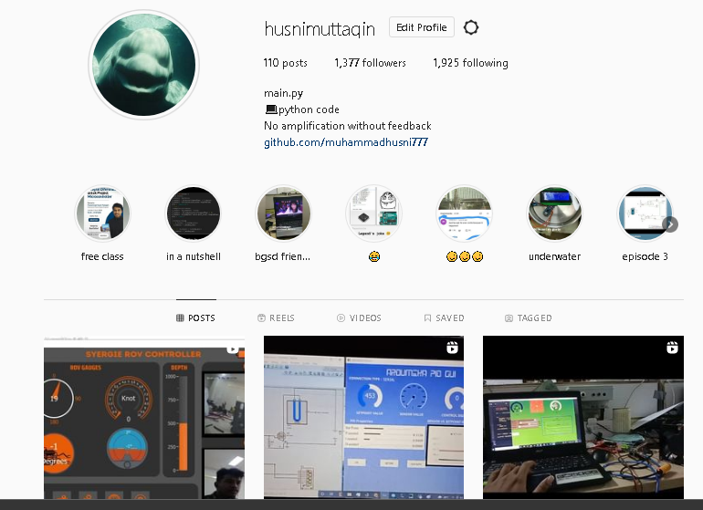
My Instagram

Slide 47
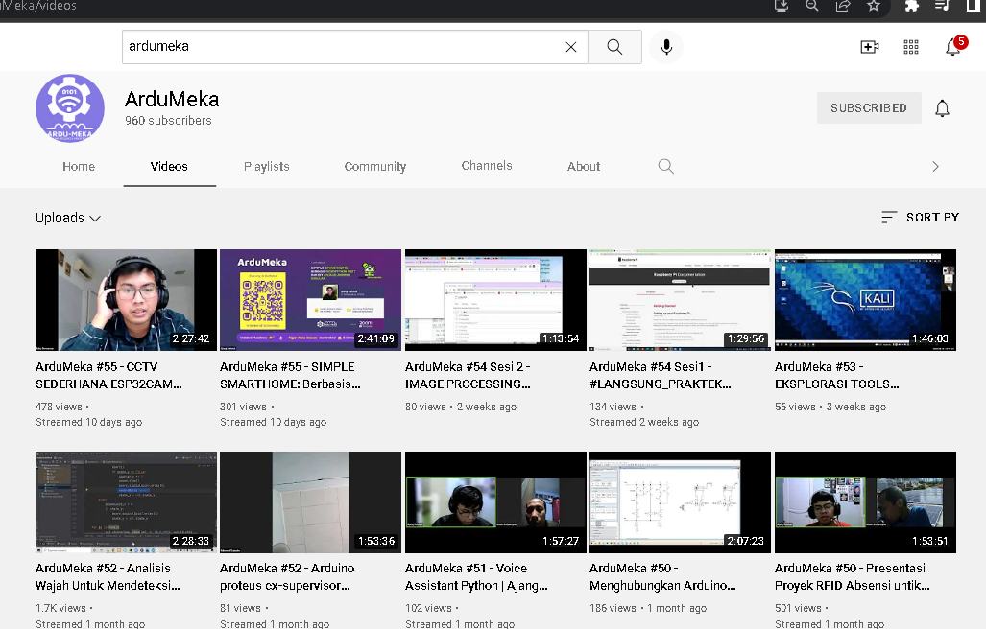
SUPPORT US

